Slide 1
TRAVEL BEHAVIOR ANALYTICS AND SMART TRIP RECOMMENDATION SYSTEM
Team Members : K. Nikhil (2320090025)
B. Joshita(2320090048)
V. Bhavya(2320030319)
Guide : Mrs.pRATHUSHA
Course: Cloud based data analytics speciality A.Y: 2025–2026

Slide 2
ABSTRACT
The Travel Data Analysis and Recommendation System is designed to analyze travel-related data and extract meaningful insights using cloud-based technologies. This project utilizes Microsoft Azure Machine Learning for data management and model training, and Power BI for interactive data visualization. The dataset includes information such as destinations, travel duration, accommodation types, costs, and traveler details. Data preprocessing techniques were applied to clean and transform the dataset, and Automated Machine Learning (AutoML) was used to train multiple models, with the Voting Ensemble model identified as the best-performing one. Various visualizations such as bar charts, pie charts, line graphs, and maps were created to analyze travel trends, cost distribution, and duration patterns. The results highlight key insights such as popular destinations, peak travel periods, and cost variations. Overall, the system demonstrates how cloud computing, machine learning, and visualization tools can be effectively integrated to support data-driven decision-making in the travel and tourism domain.

Slide 3
INTRODUCTION & MOTIVATION
Problem:
Travel decisions are complex
Generic recommendations are not useful
Travelers need personalized suggestions
Motivation:
Use cloud analytics to understand travel behavior
Real-world relevance:
Tourism industry
Travel apps
Personalized trip planning

Slide 4
Problem Statement
Existing travel recommendation platforms primarily rely on:
Popularity trends
Static reviews
Basic filtering
These systems:
Fail to analyze individual travel behavior
Do not adapt to user preferences over time
Lack scalability for large behavioral datasets
Therefore, there is a need for a cloud-based analytical system that can transform user travel patterns into actionable trip recommendations.

Slide 5
OBJECTIVES
To analyze user travel behavior using cloud analytics
To identify travel patterns based on budget, season, and preferences
To design a scalable cloud-based recommendation framework
To generate intelligent and personalized trip suggestions

Slide 6
Literature Survey
Existing systems focus on:
Review-based suggestions
Popular destination ranking
Collaborative filtering
However, they lack:
Context-aware recommendations
Cloud-based scalability
Real-time behavior analysis

Slide 7
Proposed Methodology
Approach:
Collect travel data
Store in cloud
Analyze patterns
Recommend trips
Cloud Tools:
Azure Blob Storage
Azure Blob Storage
Azure Synapse Analytics

Slide 8
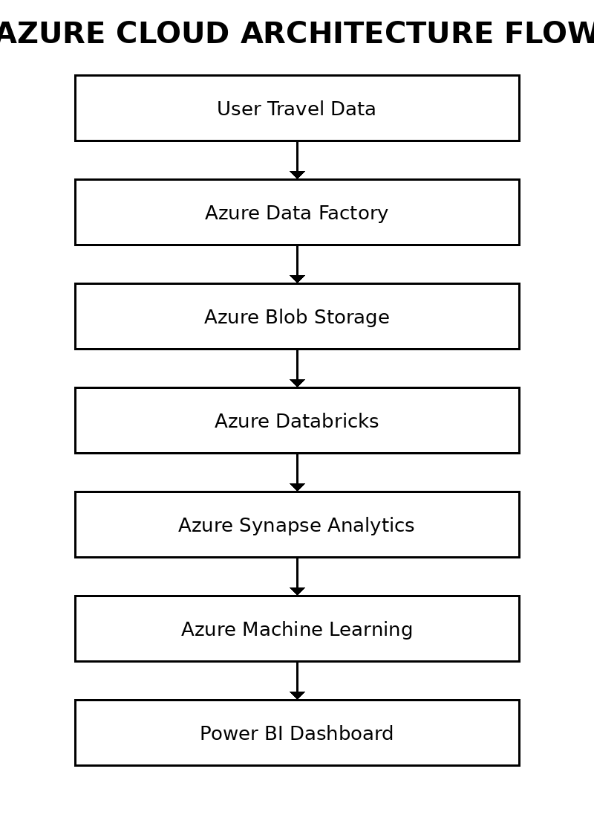
System Architecture

Slide 9
Azure Components Used
Azure Blob Storage → Stores travel datasets
⬇ Azure Data Factory → Data ingestion pipeline
⬇ Azure Databricks→ Data processing & analytics
⬇ Azure Synapse Analytics → Query & analysis
⬇ Azure Machine Learning(Python ML)
⬇ Power BI → Dashboard

Slide 10
DATA & CLOUD SERVICES USED
Data Used
Travel history
Budget patterns
Seasonal preferences
Travel type
Destination choices

Slide 11
Azure Cloud Services Used
SERVICE
PURPOSE
Azure Blob Storage
Azure Data Factory
Azure Databricks
Azure Synapse Analytics
Azure Machine Learning
Power BI
Store Travel Data
Data ingestion
Data processing
Querying
Recommendation model
Visualization

Slide 12
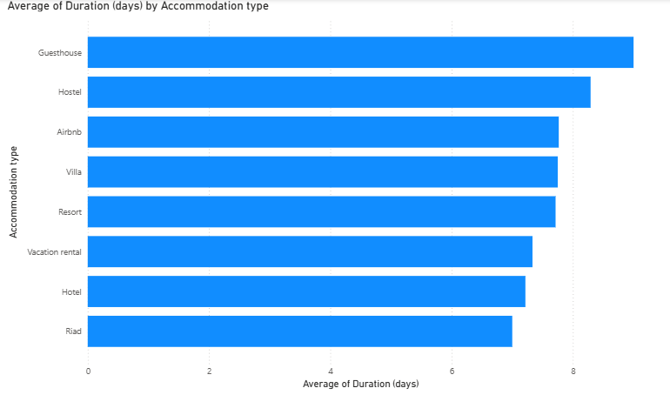
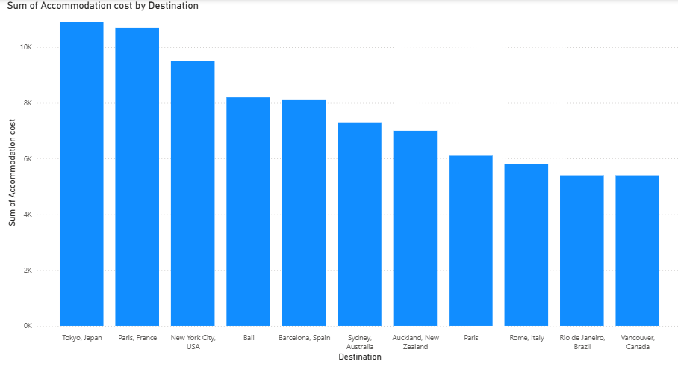
ResulTS

Slide 13
REFERENCES
Ricci et al. (2022) Recommender Systems in Travel and Tourism → Shows how user behavior improves travel recommendations
Borras et al. (2023) Personalized Travel Recommendation Systems using Data Analytics → Case study on behavior-based destination suggestions
Sun et al. (2024) Cloud-Based Big Data Analytics for Smart Tourism → Demonstrates cloud analytics in travel decision making

Slide 14
REFERENCES
Li & Wang (2023) Tourism Recommendation using User Travel Patterns → Uses behavioral insights for trip planning
AWS Smart Tourism Case Study (2024) → Real-world use of cloud analytics in tourism

Slide 15


